Slide 1
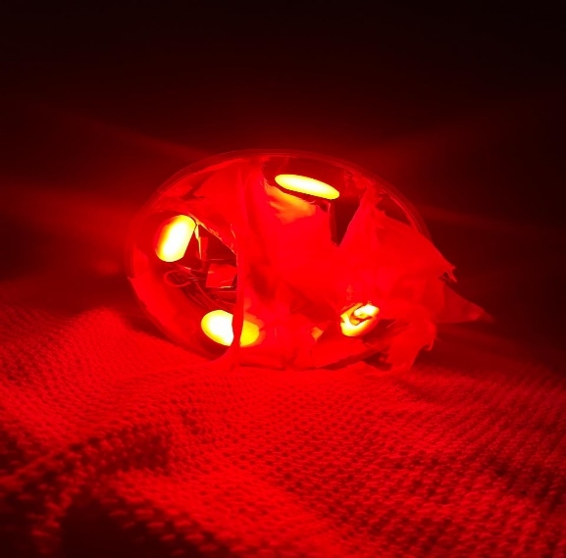
HACKVERSE 5.0

Slide 2
Table of Contents for HACKVERSE 5.0
Name of the Domain
Providing an Insight into our Team
Problem Statement
Abstract
Objective
Scope
Innovative Solution for the Problem Statement
Providing Details Of The Product Demo
Conclusion

Slide 3
Name of the Domain
THE GREEN VAULT : ENVIRONMENT & ENERGY CONSERVATION – CONSERVATION INNOVATIONS
Human Animal Conflict

Slide 4

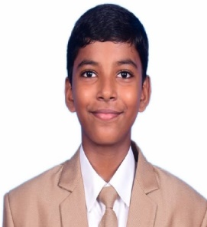

Sacred Heart International School
Pamam , Marthandam , TamilNadu
Providing an Insight into our Team
Our Team
Team Leader
CHRISBIN JAEDON
VII STANDARD
chrisbinjaedon2012@gmail.com
9443745515
Member
CHRISBIN LIANA
X STANDARD
chrisbinliana2009@gmail.com.
9487786515

Slide 5
Problem Statement
In recent years, there is a threat for the villagers living in the vicinity of a forest to be invaded by the wild animals especially during nights.
This is a major threat to the life of the people residing in such parts of the land.
Normally, forest officials as well as villagers use sound in the form of crackers and fire to drive away such intruding wild animals in places where people live.

Slide 6
In some case these crackers and fire used are not properly put off may create fire accidents and forest fire ending in huge loss as well as polluting the air and environment.
Therefore a solution must be found out to prevent wild animal human conflict and at the same time the environment should be protected.
This work focuses on this and try to find a solution to solve it.

Slide 7
Abstract
The Human Wildlife Conflict is common along the fringes of forests. To protect the crops people are using physical barriers solar power fences, also wild animal repellent is available in the market. A large population is living on the fringe areas which are lying close to the forest areas.
Bearing this in mind, a new device has been developed in the form of a handy torch so that people can easily use it to drive off the wild animals intruding into their places.

Slide 8
Objective
The main objective of the work is to protect the people living close to the forest areas from the attack of wild animals. The method followed currently create noise as well as air pollution. In many cases the animal is killed.
To overcome this, we have proposed a device, similar to a flashlight, handy and easily usable to prevent people from wild animal attacks in emergency cases. This is eco friendly, easy to use for any layman. This will reduce human animal conflict and protect both the human and the animal.

Slide 9
Scope
The better option to save the lives of the animal and human is to drive away the animal from the spot so that it does not attack the humans or livestock.
This is a first step to protect the humans/livestock from the attack.
Similarly we can do the same in cultivating areas so that crops are protected.

Slide 10
Innovative Solution for the Problem Statement
A new device has been developed in the form of a torch in a handy way so that people can easily use it to drive off the wild animals intruding into their places.
The device imitates the fire and cracker sound which is implemented using latest technology. In case of an emergency, people can switch on the device to drive away the intruded animal from the spot.
Instead of waiting for the forest officials to come and save, people can use this device and protect themselves from any animal attack.
The device is eco-friendly and do not produce any smoke or similar gases. It is rechargeable and provided with necessary ports for charging.

Slide 11
On switching on the device, it flashes a bright red light in the front with huge sound.
As an initial step, the device was used to drive away stray street dogs which are dangerous and anytime attack pedestrians.

Slide 12
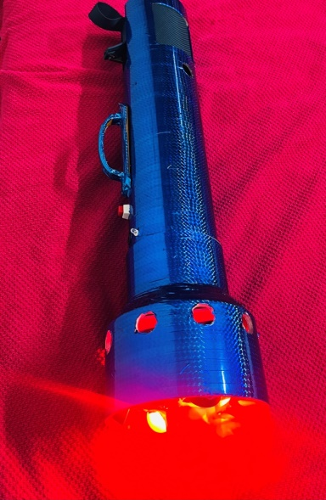

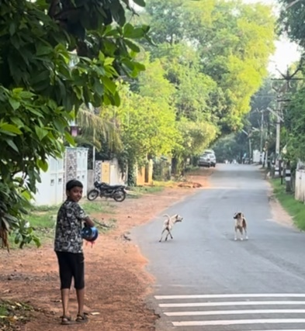
Providing Details Of The Product Demo
Details of Pilot demonstration and expert validation location/s and details of validation of pilot.
S.No. | Name of the Expert/Officer | Location of Demo | Remarks
1 | District Forest Officer (DFO), Wild Life Warden Kanyakumari District | Office of the DFO, Nagercoil | Appreciated. Needs more refinement and improvement to implement in large scale. Recommended for Bal Purashkar Award.
2 | Mr. T. Rajesh Kanna IFS, Deputy Director Sanjay Tiger Reserve Madhya Pradesh | Demo through Online | Appreciated the effort. Recommended for Bal Purashkar Award.
3 | Dr. K S Kasiviswanthan, Ph.D. Associate Professor Department of Water Resources Development and Management Indian Institute of Technology Roorkee | During his visit to Chennai at a Private Place. | Very well appreciated and suggested few improvements incorporating IoT and sensors. Recommended for Bal Purashkar Award.

Slide 13
4 | Dr. T. Senthilkumar, Ph.D. Dean University College of Engineering, Tiruchirapalli | University College of Engineering, Tiruchirapalli | Appreciated the efforts to make the prototype. Recommended for Bal Purashkar Award.
5 | Mr. Murugan M District Educational Officer (Private Schools) Kanyakumari District | Office of the Chief Education Officer, Kanyakumari District | Appreciated the effort. Recommended for Bal Purashkar Award.
6 | Dr Paul McKenna Manager (Environment & Sustainability) Lancaster Environment Centre Lancaster University, UK Centre for Global Eco-Innovation | Demo through Online | Appreciated the effort and encourage to continue the great work.
World Book of Records UK, Forbes World Records Certification Services Co., Ltd. UK, India Book of Records and World records India considered the work as an innovative one and awarded “Youngest to Make a Device to Protect from Wild Animals”.

Slide 14
Identity tangible advantages IPs and patents etc
A patent was published in the name
Mr. Y. Chrisbin Jeeva, F/o Chrisbin Jaeden
Device with Artificial fire flame and speaker to protect from wild animals. Application number: 202341080099, Publication number: 13/2024, Publication date: 29.03.2024.

Slide 15
Conclusion
We need to stop human wildlife conflict which is not ending with human lives but also affects live stocks, damaging cultivation lands etc.
The entire set up of the device is safe and does not make any harm to the wild animal as well as the environment. Moreover this is rechargeable and people can use it like a Torch Light and carry wherever they want.

Slide 16
References
All Recommendation Letters
    https://drive.google.com/file/d/1co1n0ZOZlCl948vK9uY4P2aI9poMfK77/view?usp=drive_link
Prototype device Video
    https://drive.google.com/file/d/1m0AsdGYqerJS1vF5sltLiPn-pckeoxoO/view?usp=drive_link
Device demo
    https://drive.google.com/file/d/1dsu6w93QBOnPTYb4A77OE9mT4O_ZcY-X/view
Patent
    https://drive.google.com/file/d/151kU48JE_fJWdjrihop1eg-8XWUWbzpk/view?usp=drive_link

